Slide 1

Crumble
Trigg La Tour, Manoj Seeram, Josh Lewis

Slide 2

Person - Jeff
Person - Steve
Needs an ADVENTURE
Had An Adventure
Needs a Goal
Needs to Share It
Finds a Crumb
Leaves a crumb
Crumble
Notes:
This is for when you know where you want to go but you don’t know what to do there. The internet has other forums for when you know what you want to do but don’t know where to. go.

Slide 3
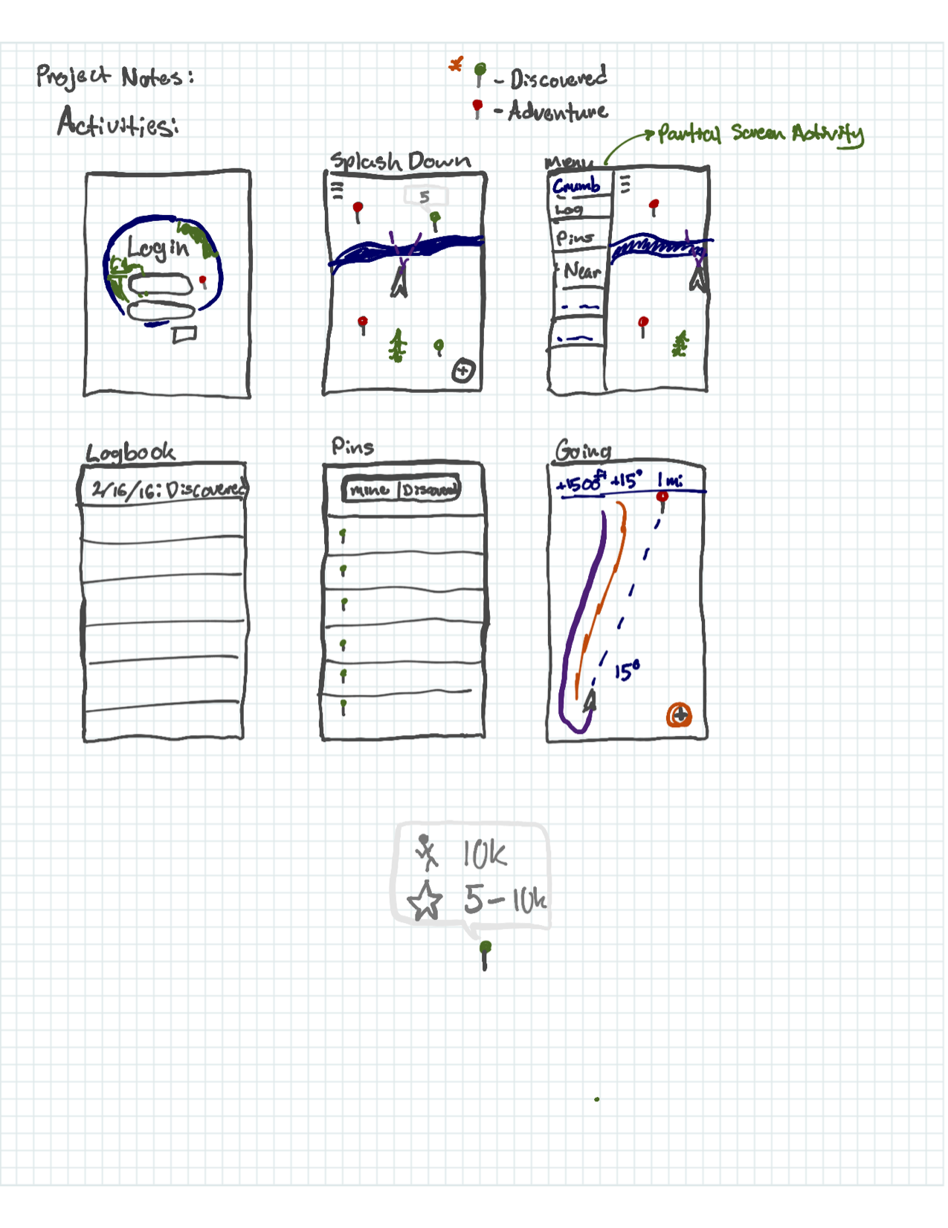
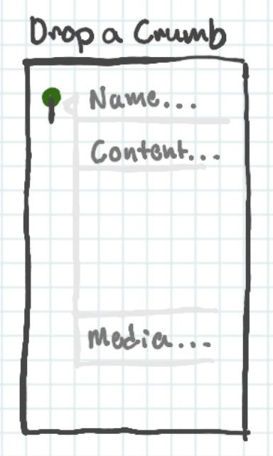
Anatomy of Crumble

Slide 4
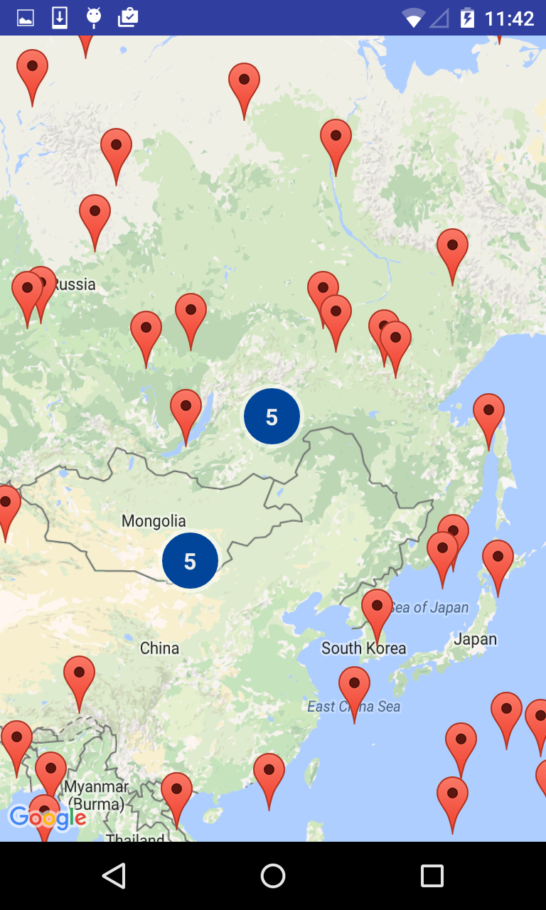
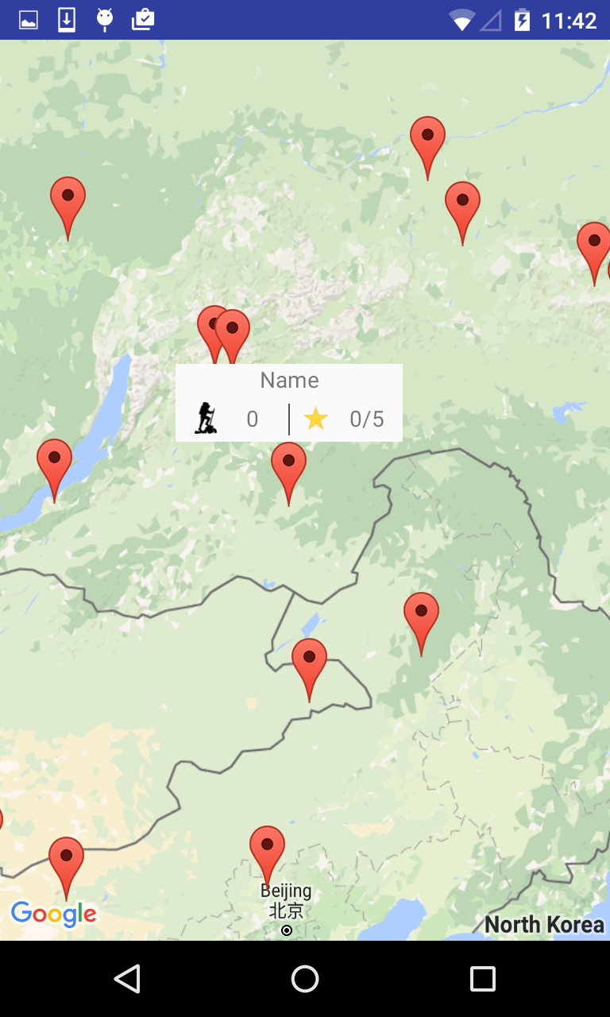
POV - Jeff
Sketch
Our Application
Finding a Crumb
Selecting A Crumb

Slide 5
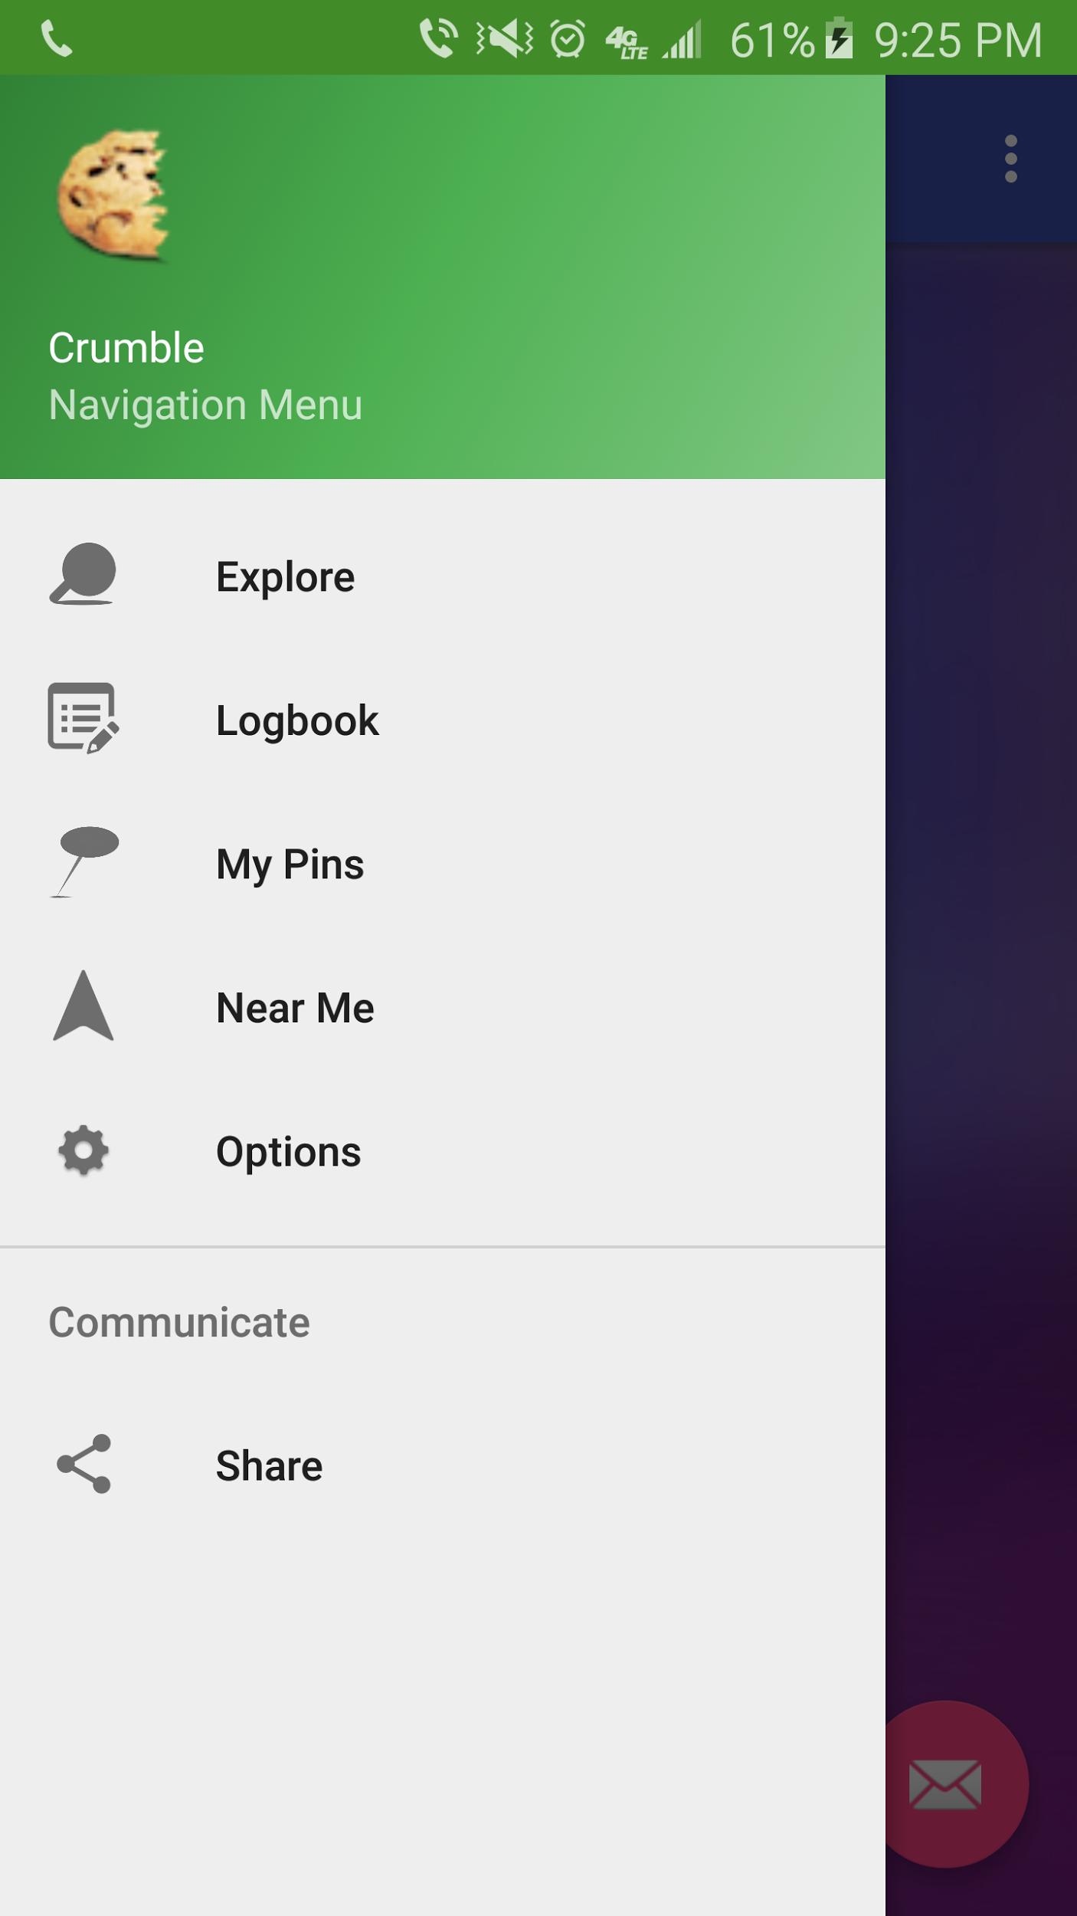
POV - Jeff
Sketch
Our Application

Slide 6
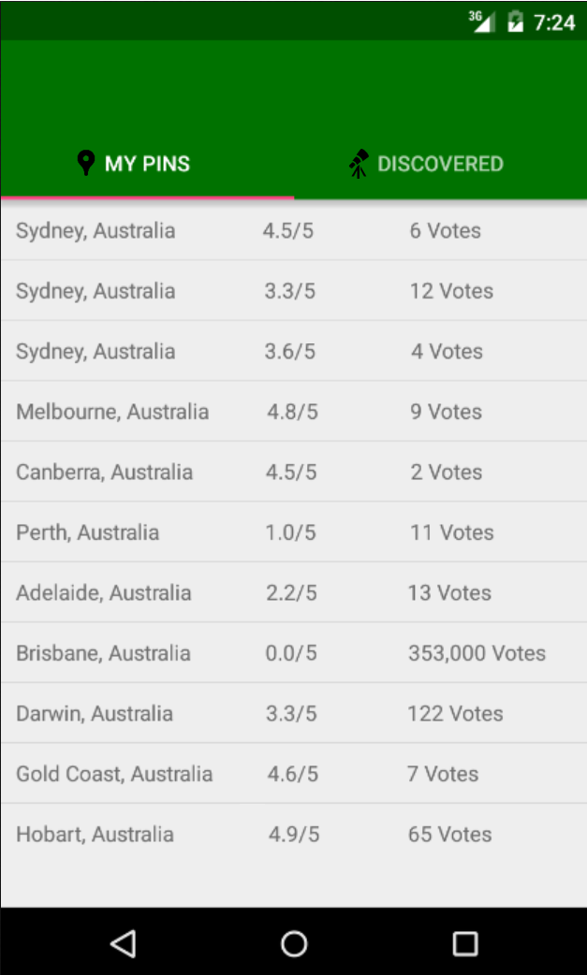
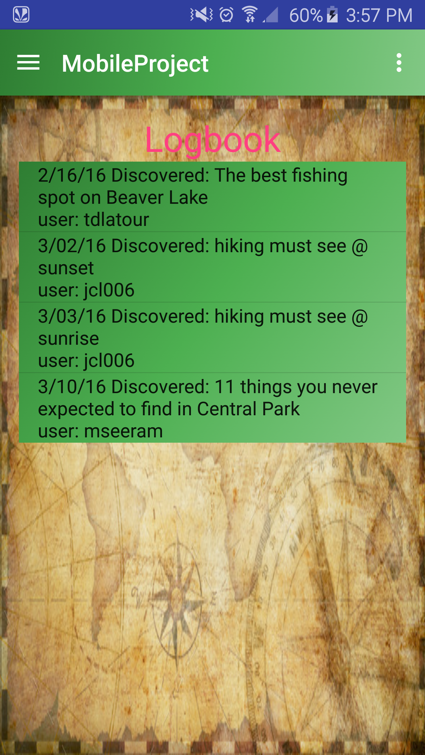
POV - Steve
Sketch
Our Application

Slide 7

The Bar So Far
Design and Develop Idea
Format SQL Database
Integrate Google Maps
Set up LAMP Server
Connect app to database via PHP
Design app activities

Slide 8
Going Forward
Complete the UI
Synchronize app with server
Enable offline map saving for off-path users*
*Stretch Goal

Slide 9
...And that’s the way the cookie crumbles!

